Slide 1
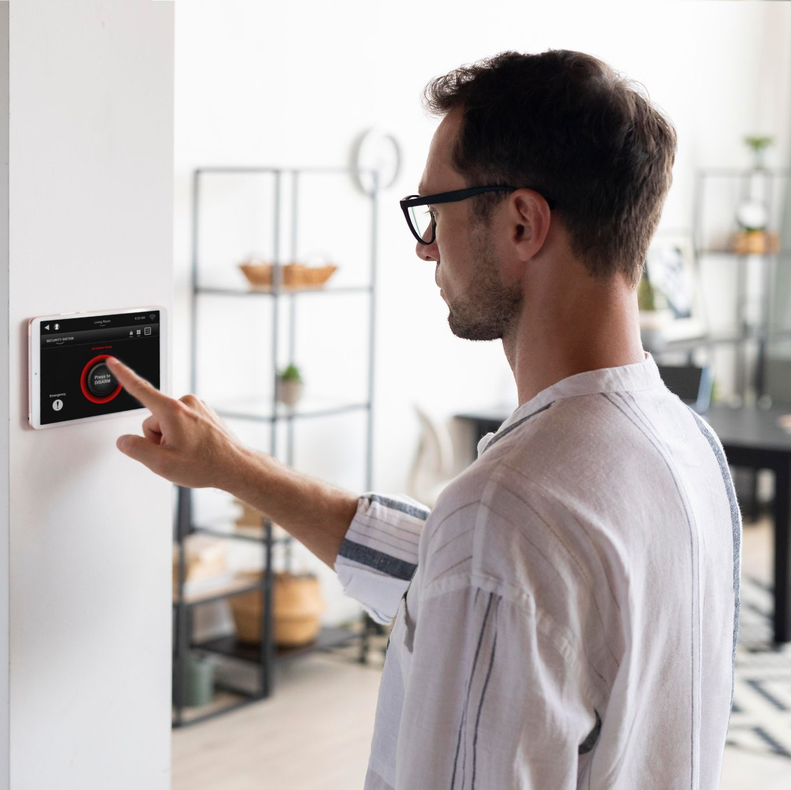
SMART HOME Control And Monitoring System
Supervised By: DR Tamer Abdelkader
Malek Sayed (203711)
Reem Amr Emara (206598)
Shady Zafer (193276)

Slide 2
TABLE OF CONTENTS
Model Architecture
BlockChain
01
04
Hardware Implementation
PROJECT STAGES
02
05
MQTT
Flutter
03
06
You can describe the topic of the section here
You can describe the topic of the section here
You can describe the topic of the section here
You can describe the topic of the section here
You can describe the topic of the section here
You can describe the topic of the section here

Slide 3
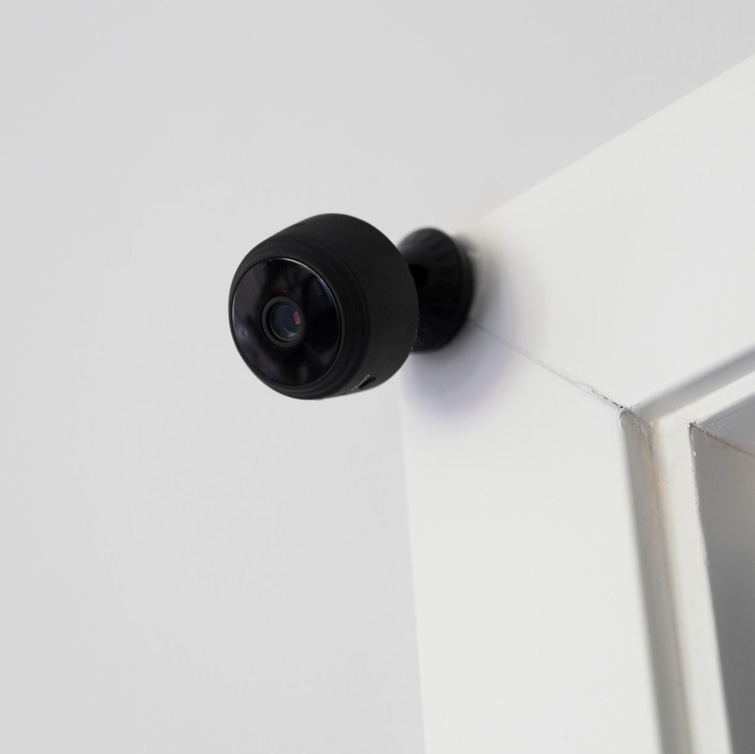
01. Problem Statement

Slide 4
Problem Statement
Challenges In Existing Systems
High Energy Consumption
Security & Privacy Concerns

Slide 5
02. Research Objectives

Slide 6
Research Objectives
Smart Home Application
BlockChain Integration

Slide 7
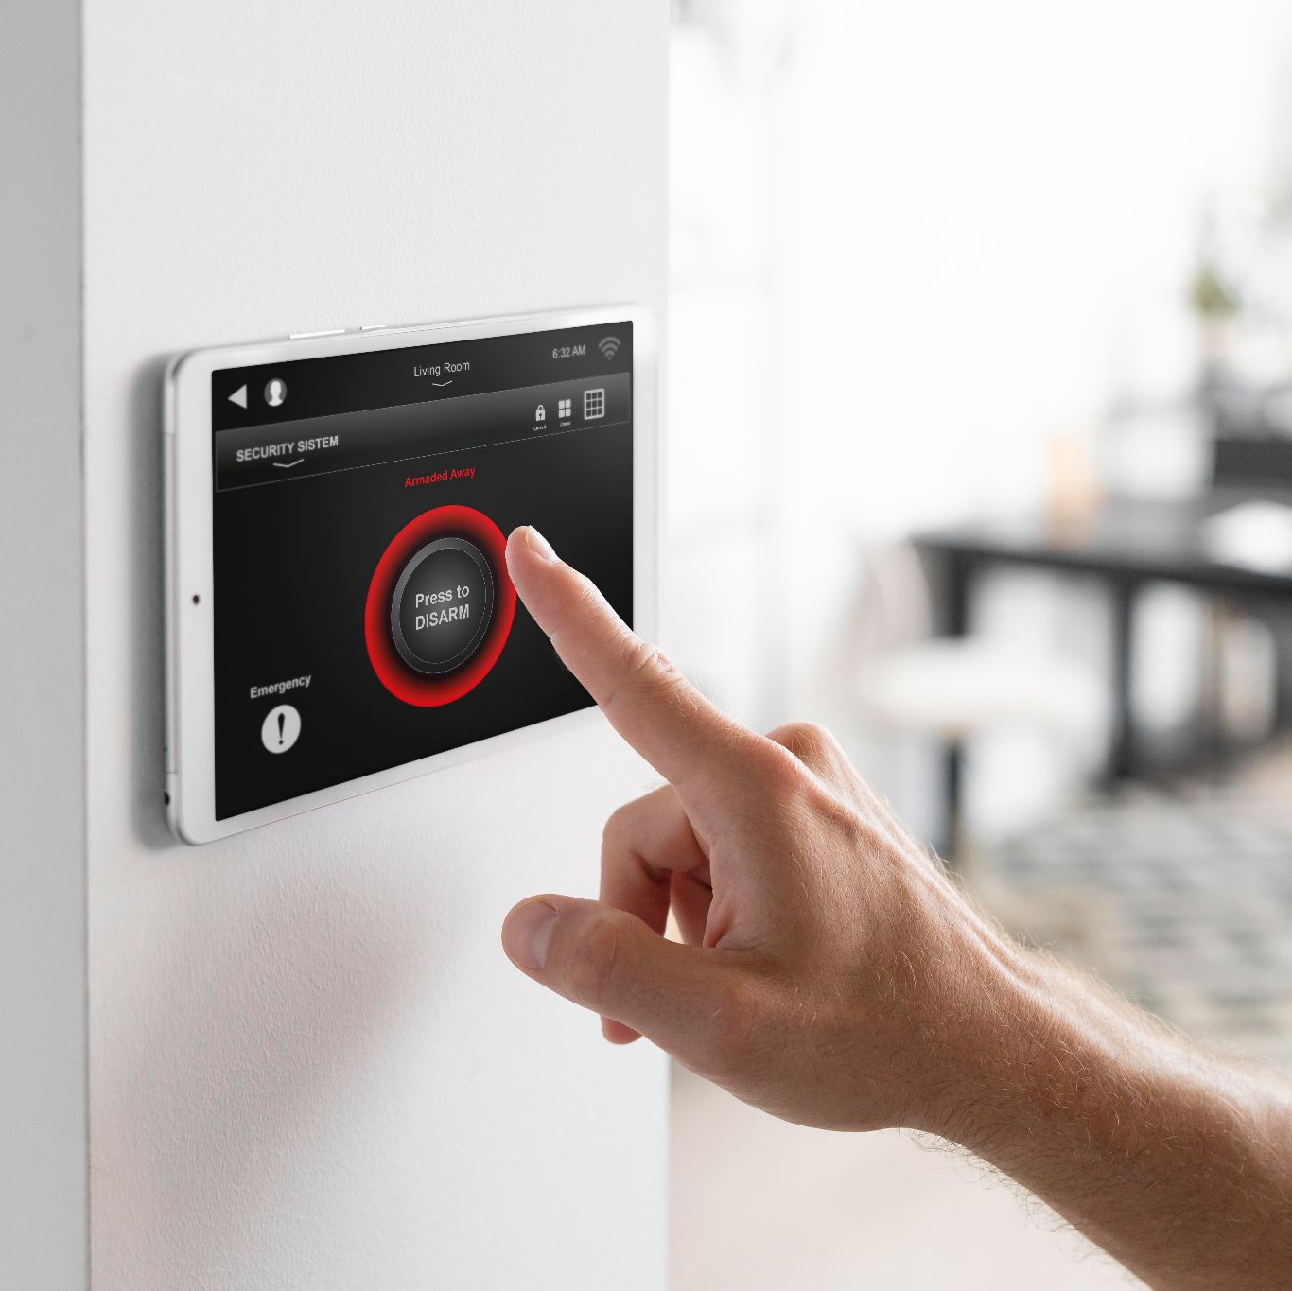
01.
Model Architecture

Slide 8
Model Assembly Process
Model Design
Material Gathering
Setting Up Materials
Model Assembly
Model Decoration

Slide 9
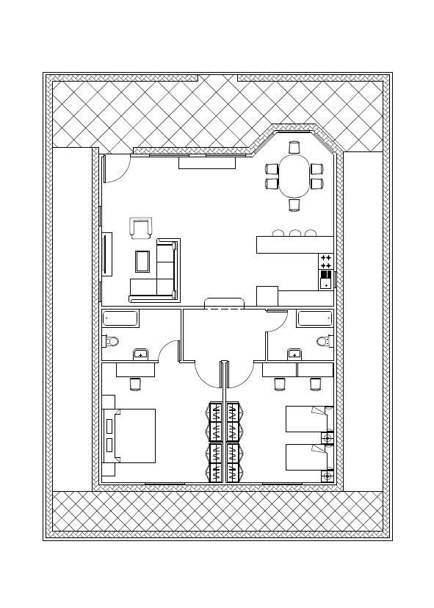
Model Design
Living Room
Outdoors
Bathroom
Bedrooms

Slide 10
0.2 BlockChain

Slide 11
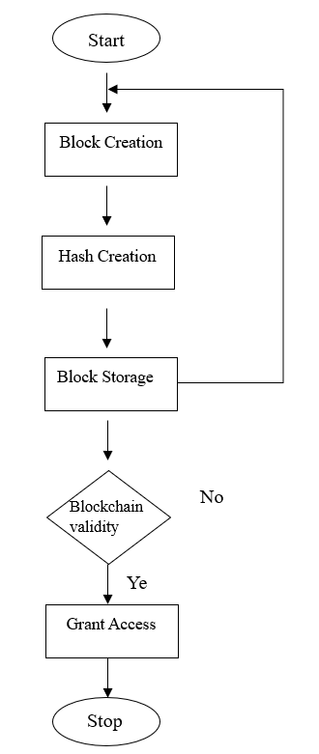
BlockChain Implementation
01
02
03
BlockChain implementation in java
Using hash technique
SHA-256
Authenticate user credentials using HTTP

Slide 12
0.2 MQTT

Slide 13
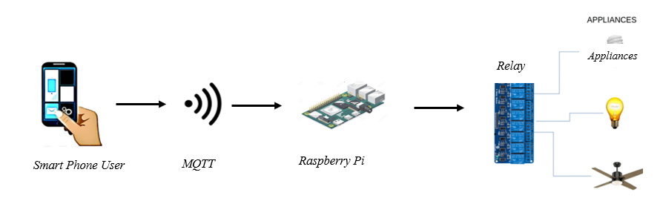
MQTT Flowchart

Slide 14
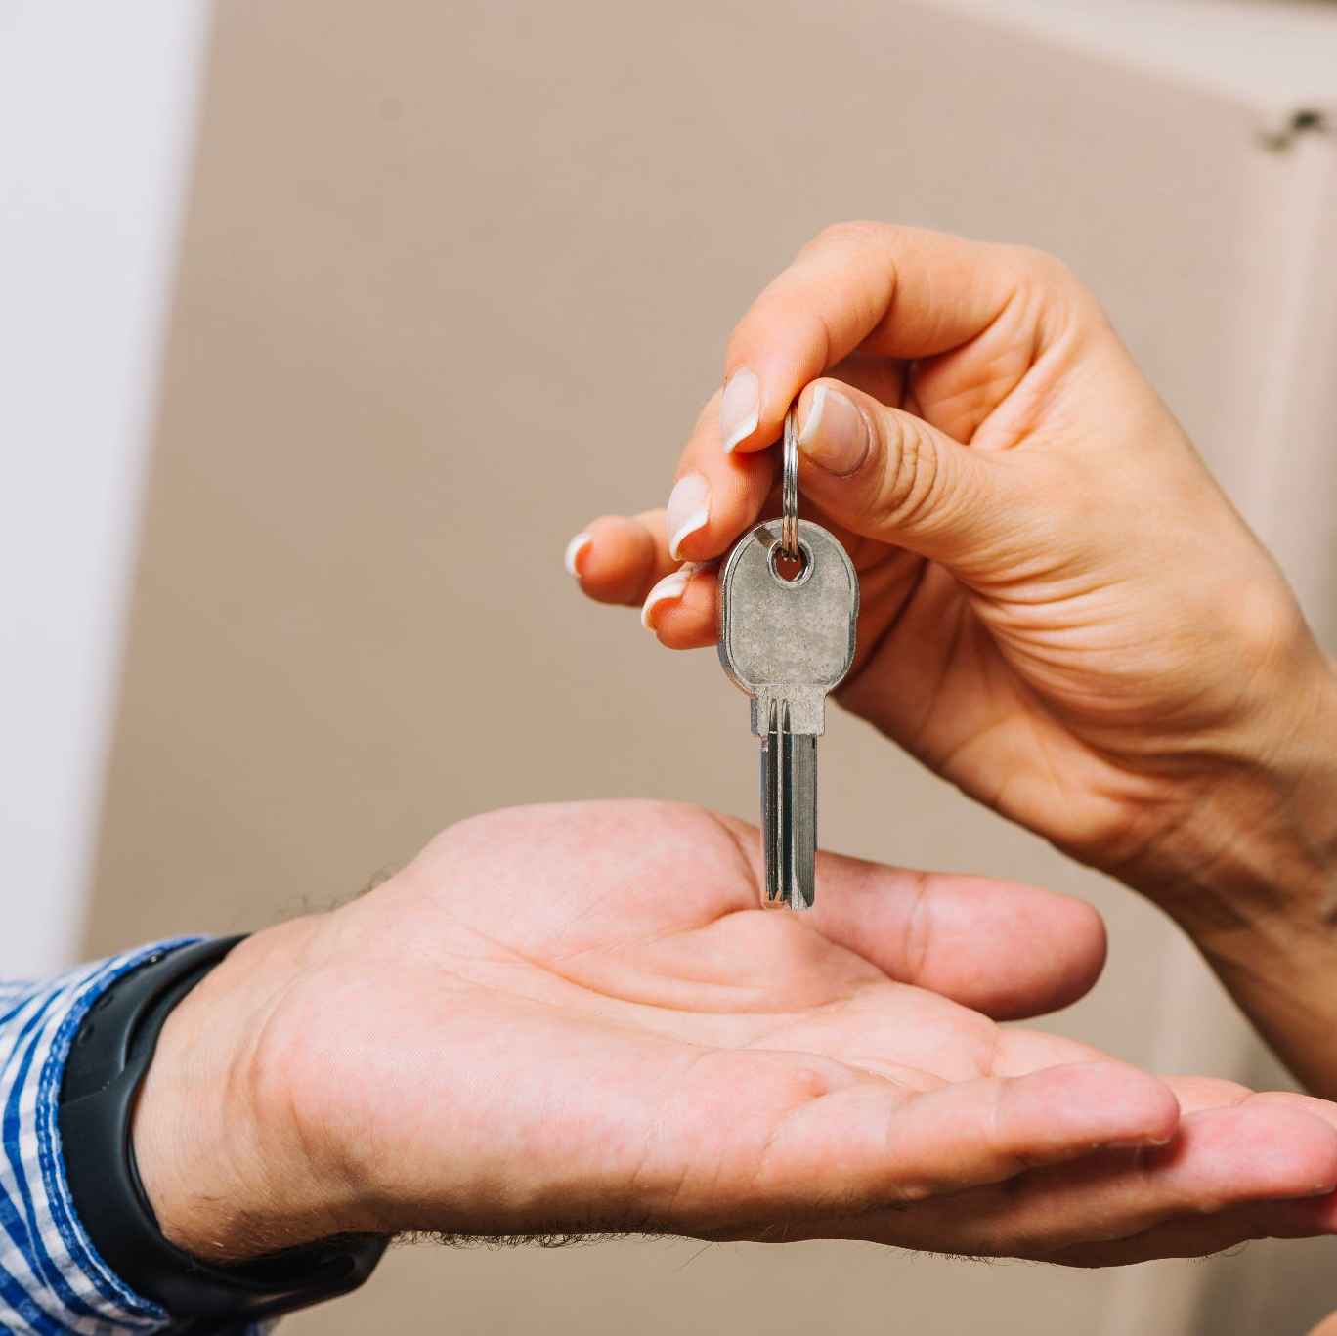
0.3 Hardware

Slide 15
Hardware Implementation
01
02
03
08
Raspberry Pi 4
LDR Sensor
09
DHT11 Sensor
Front Door LEDs
10
Fan
Raindrop Sensor
04
11
2 Relay Modules
Servo Motors
05
12
PIR Motion Sensor
Power Supply
06
13
Flame Sensor
Power Supply Switch
07
14
Buzzer
Breadboard and Wires

Slide 16
04.
Flutter Application

Slide 17
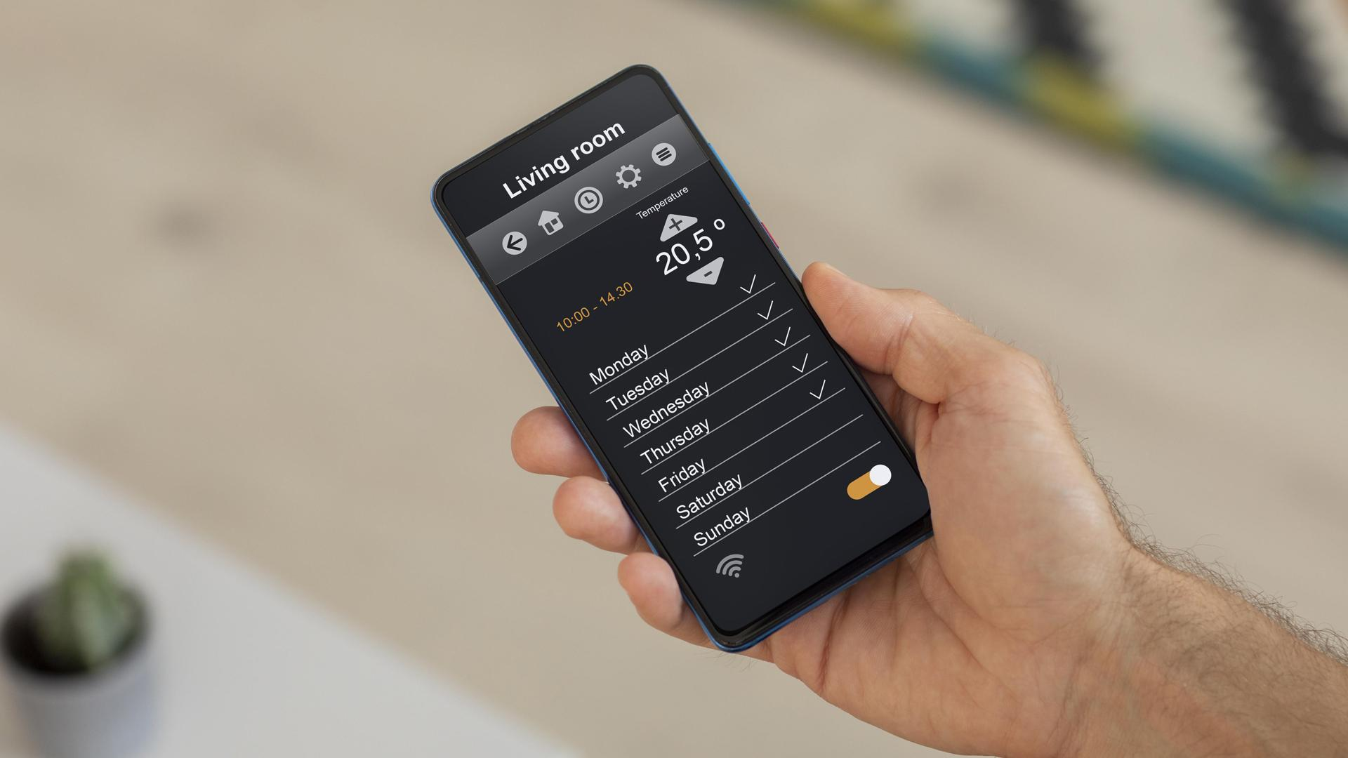
Why use Flutter?

Slide 18
MQTT in Flutter
MQTT Client Setup
Connection management
IP address and port number are entered into the Broker.
Username and password are used for authentication
Initializes the MQTT client and attempts to connect to the broker. If successful, it subscribes to several topics
Message Handling
Sensor Data Collection
This Dart code for a Flutter app
connects to an MQTT broker, subscribes to sensor topics, processes messages, and updates the UI with new data.
Represents sensor data with temperature, humidity, and timestamp fields. Includes a factory constructor for creating instances from JSON.

Slide 19
HTTP in FLutter
*
This Dart code for a Flutter app handles HTTP requests to a specified server. It includes a `BaseClient` class with methods to perform GET and POST requests, manage responses, and log debug messages. The `Welcome` class is used for serializing and deserializing user data (username and password) to and from JSON.

Slide 20
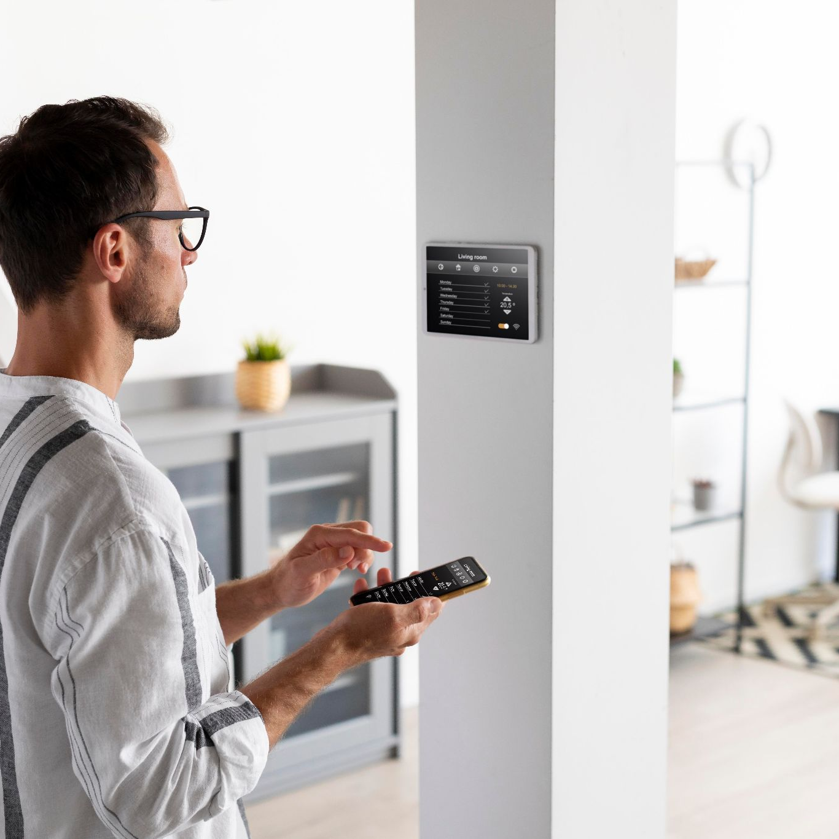
FUTURE WORK

Slide 21
Future Work
01
02
03
Voice Control Integration
Enhance Energy Prediction
Deploy More Complex Blockchain Algorithms

Slide 22
Thank YOU!

